Slide 1
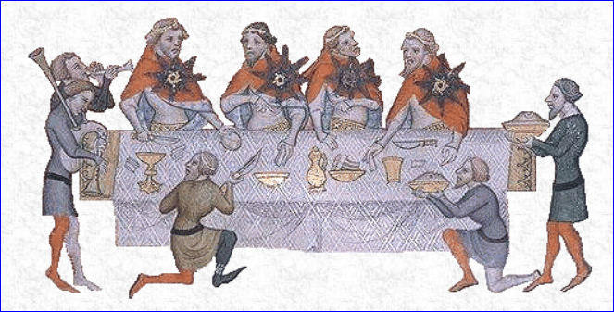
Interpreting Period Recipes Mistress Gwyneth Espicier, Calontir

Slide 2
Adapting period recipes for modern use
Choose a recipe. There are two main types of sources for finding period recipes: primary and secondary.
Primary sources – original period documents or copies of them posted online, stored on microfilm, or reprints/facsimiles of the originals.
Secondary sources – modern books or websites that quote or paraphrase period sources (like Pleyn Delit, The Medieval Cookbook, To the Queen's Taste, or http://www.godecookery.com/).

Slide 3
1. Choose a recipe
Where to find sources
Libraries – You can usually find both types of sources in a good university library or through inter-library loan. Try looking in the subject catalog under "Cookery--early works to 1800". This will get you mostly primary sources. Try looking up some of the books you already know about, and see where they are, then look at neighboring books. Try browsing the shelves in the TX 600's, TX 700's and GT 2850's.
Websites – There are a number of websites that serve as good secondary sources. On them, the author has typed up transcriptions and/or translations of original recipes. Some of them also include modern interpretations of the original recipes. For a list of some good websites, see Web Sites in the handout.
Books – There are a lot of great books with period recipes that you can order online. For a list of some of my recommended sources, see Books in the handout.

Slide 4
2. Decide what type of food your recipe will make
Is it a stew, a quiche, a pudding, a pie?
Example: cheese, eggs, breadcrumbs, butter, “good spices”
This will help you make decisions in the following steps.

Slide 5
3. Check out the ingredients
Refer to glossaries (if available) for unfamiliar terms.
Consider what substitutions you might want or need to make (e.g., chicken for pork, beef for venison, butter for bone marrow, etc.).

Slide 6
4. Decide on approximate quantities
Look for hints:
Does the recipe give quantities for some of the ingredients?
Does it say how many it will serve?
Does it mention the consistency of the dish?
Think generously when buying ingredients.

Slide 7
5. Plunge in
Start with fairly small quantities when adding ingredients. You can always add more.
Keep track of the amounts added, so you can duplicate your finished product.
Taste frequently; add seasonings as needed.
If you need general guidelines as to amounts of ingredients to use and cooking temperatures and times, consult a modern cookbook.

Slide 8
Some common basic ingredients
Thickening and binding agents
Coloring agents
Leavening agents
Flavoring agents
Dried fruit
Spices
Miscellaneous ingredients

Slide 9
Thickening and binding agents
Bread crumbs – these can be from fresh or slightly stale bread, either torn into very small crumbs, or run through a food processor. Avoid using the packaged, dried bread crumbs. They are gritty and take a long time to absorb liquids.
Hard-boiled egg yolks - often used in stuffings, sauces, and meatballs.
Raw eggs and egg yolks – used to thicken sauces and puddings, and to bind ingredients together.
Flour – wheat and rice flour (and sometimes oatmeal) are used to thicken sauces.

Slide 10
Thickening and binding agents, continued
Almond milk – finely ground almonds (generally blanched) steeped in broth, wine, or water. Used to thicken sauces and as a milk substitute on fast days. Here is a basic recipe (just replace the water with whichever liquid is called for in your recipe):
Cold Mylk of Almondes- from The Forme of Cury (ca. 1390), [as reproduced in Duke Cariadoc's A Collection of Medieval and Renaissance Cookbooks, Vol. I].
To mak cold mylk of almondes put fair water in a pot with sugar or honey clarified so that it be douce. Then salt it and set it on the fyere and when it is at boilling scom and let it boile awhile. Then tak it from the fyere and let it kele. Then blanche youre almondes and grind them, and temper them with the same water in to a good thik mylk...

Slide 11
Coloring agents
Yellow – saffron or raw egg yolks (for endoring [gilding])
Blue – turnsole
Red – alkenet or sanders (sandalwood)
Green – juice of parsley or spinach
"Black" – toasted bread crumbs or blood (can use Kitchen Bouquet as a substitute)

Slide 12
Leavening agents
Barm – the foamy yeast that occurs as a result of fermentation in ale. Try substituting yeast.
Eggs – for leavening, these were beaten until foamy and stiff. Generally used for cakes and "biskets".
Yeast – this was occasionally used, but barm shows up in more recipes.

Slide 13
Flavoring agents
Verjuice – the juice of crabapples or unripe grapes. Possibilities for substitution include lemon juice or grape juice with a little wine vinegar added (it should be tart, but not as acid as vinegar). If you try to make your own, I suggest not running grapes through a food processor or blender. This cuts the seeds, making the juice extra bitter. It is a pain, but the best method is crushing the grapes in a mortar, putting the juice and pulp in a cloth and squeezing the juice out. Some Middle Eastern groceries also carry bottled verjuice.
Rosewater – rose-flavored water made by distilling rose petals. Available at exorbitant prices in gourmet shops, or more reasonably at most Middle Eastern groceries.

Slide 14
Dried fruit
Reysons of corrance – dried “currents” [these are actually small dried grapes, rather than red or black currants]
Raisins of the sun – raisins
Prunes
Dates
Figs

Slide 15
Spices (of the more exotic sort)
Cubeb – an aromatic berry from Java that resembles a peppercorn. Often available in health food stores. If you need a substitute, try half pepper, half allspice.
Galingale – an aromatic root, purchased powdered. Often available in Asian groceries, where it is sometimes called "laos". It is related to ginger, which you could use as a substitute.
Grains of paradise – seeds of a West African plant. According to Lorna J. Sass, they are related to cardamom, which may be used as a substitute. I find them to be sharp and a little peppery, as well as slightly sweet, so if you use cardamom, you might add a little pepper, too.
Powder fort and powder douce – strong powder and sweet powder. These were mixtures of spices the cook would have kept on hand to use as we would curry powder or seasoned salt. There seems to be no standard mix for either sort of powder, so experiment with different blends--perhaps cubeb, mace, pepper and cloves for powder fort and ginger, sugar, coriander, and cinnamon for powder douce.

Slide 16
Miscellaneous ingredients
Mary or marybones – bone marrow. You can substitute butter (which is even a period substitution).
Worts – greens or pot-herbs, especially of the cabbage family (colewort is cabbage).

Slide 17
Recipes for Discussion
To Make Bisket Bread- from Elinor Fettiplace's Receipt Book (1604) by Elinor Fettiplace
Saffron Potage- from De honesta voluptate (1475) by Platina
Capon stewed- from Yale Univ. ms Beinecke 163 (15th c.)
To Bake Chekins in Lyke Paest- from A Proper Newe Booke of Cokerye (ca. 1574)
Mon amy- from A compendyous regyment of a dyetary of helth, made in Montpylior (1542) by Andrew Boorde

